Slide 1

Geometry
Unit 1, Lesson 5 Transformations on the Plane – Part 1 Volume 1, pg. 27

Slide 2


Benchmark
MA.912.GR.2.3
Identify a sequence of transformations that will map a given figure onto itself or onto another congruent or similar figure.
volume 1, pg. 27

Slide 3
Integrated Mathematical Thinking and Reasoning Standards
MA.K12.MTR.1.1 Actively participate in effortful learning both individually and collectively.
MA.K12.MTR.2.1 Demonstrate understanding by representing problems in multiple ways.
MA.K12.MTR.4.1 Engage in discussions that reflect on the mathematical thinking of self and others.
MA.K12.MTR.5.1 Use patterns and structure to help understand and connect mathematical concepts.
volume 1, pg. 27

Slide 4

Learning Targets
I can identify the angle of rotation of a transformation of a figure on a plane.
I can identify the center of rotation of a transformation of a figure on a plane.
I can identify the direction of a rotation of a transformation of a figure on a plane.
I can distinguish a rotation from other transformations.
volume 1, pg. 27

Slide 5

Warm-Up
volume 1, pg. 28

Slide 6
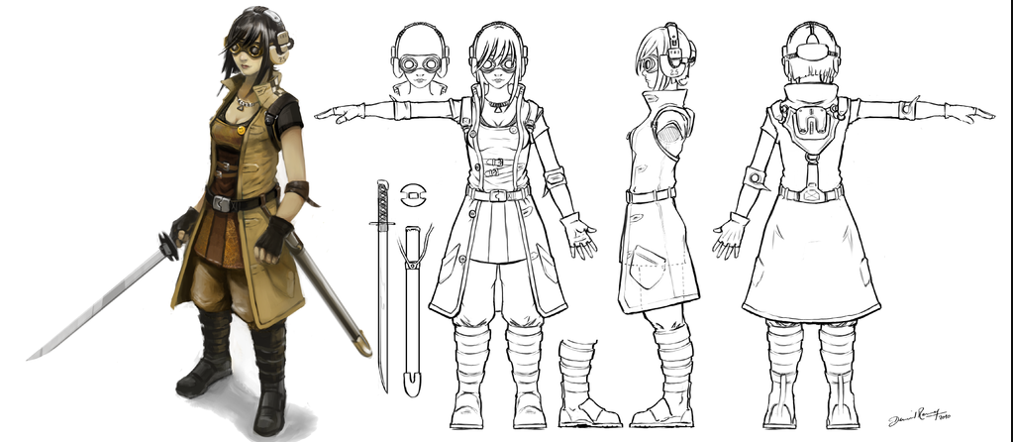
1.5.1 Warm-Up: Rotations in Drawings
The picture shows the front, side, and back view of an animated character.
What do you notice about all three views — front, side, and back, of the animated character?
volume 1, pg. 28

Slide 7
When animators and cartoonists sketch the movement of a character, they use a sheet like the one shown.
Front | Side | Back
volume 1, pg. 28

Slide 8

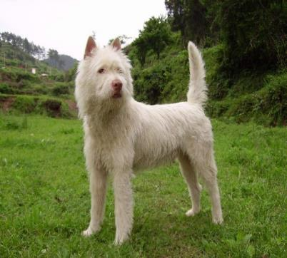

Use one of the pictures below, or your own idea, to sketch the three views. Use the dotted lines to help you align key features of the picture.
volume 1, pg. 28

Slide 9

Guided Instruction
volume 1, pg. 29

Slide 10
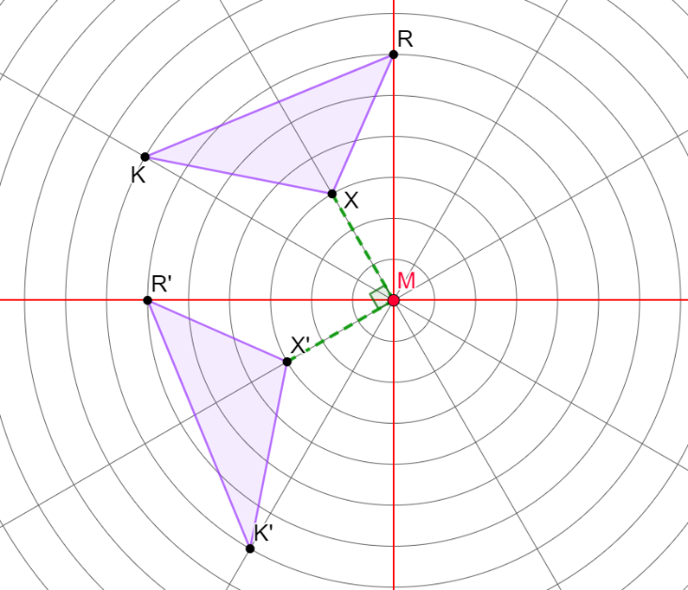






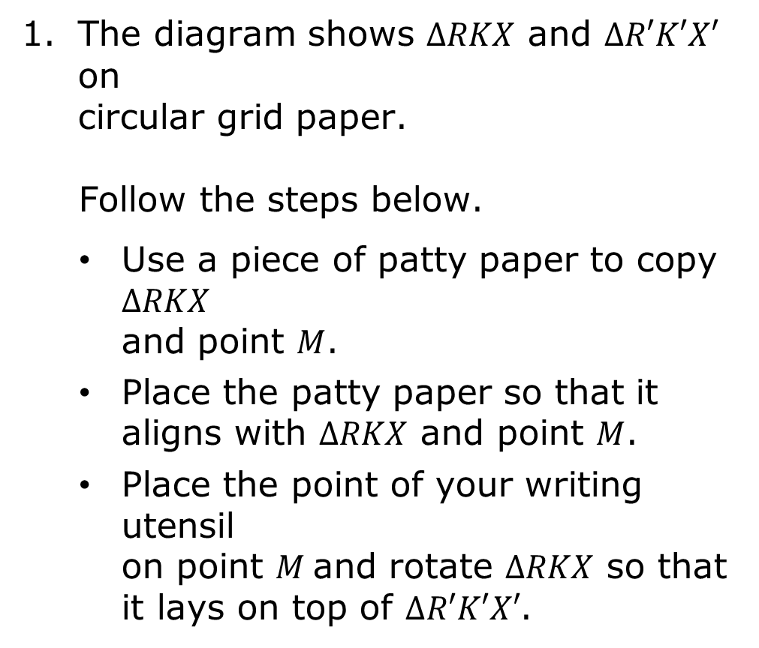




1.5.2 Guided Instruction: Transformations on the Plane
The diagram shows $∆RKX$ and $∆R′K′X′$ on circular grid paper.
Follow the steps below.
Use a piece of patty paper to copy $∆RKX$ and point $M$.
Place the patty paper so that it aligns with $∆RKX$ and point $M$.
Place the point of your writing utensil on point $M$and rotate $∆RKX$ so that it lays on top of $∆R′K′X′$.
$$90°$$
$$120°$$
$$60°$$
$$150°$$
$$30°$$
$$180°$$
$$330°$$
$$210°$$
$$300°$$
$$270°$$
volume 1, pg. 29

Slide 11
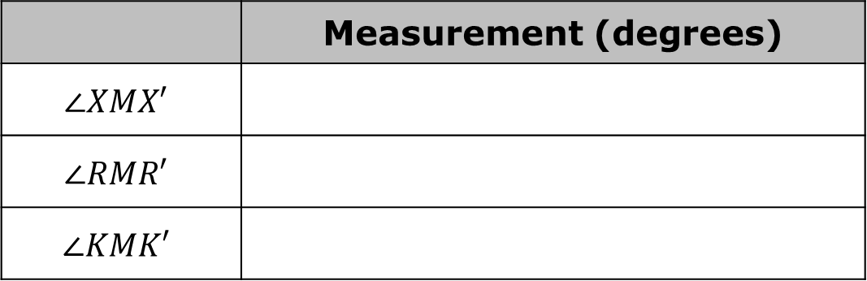
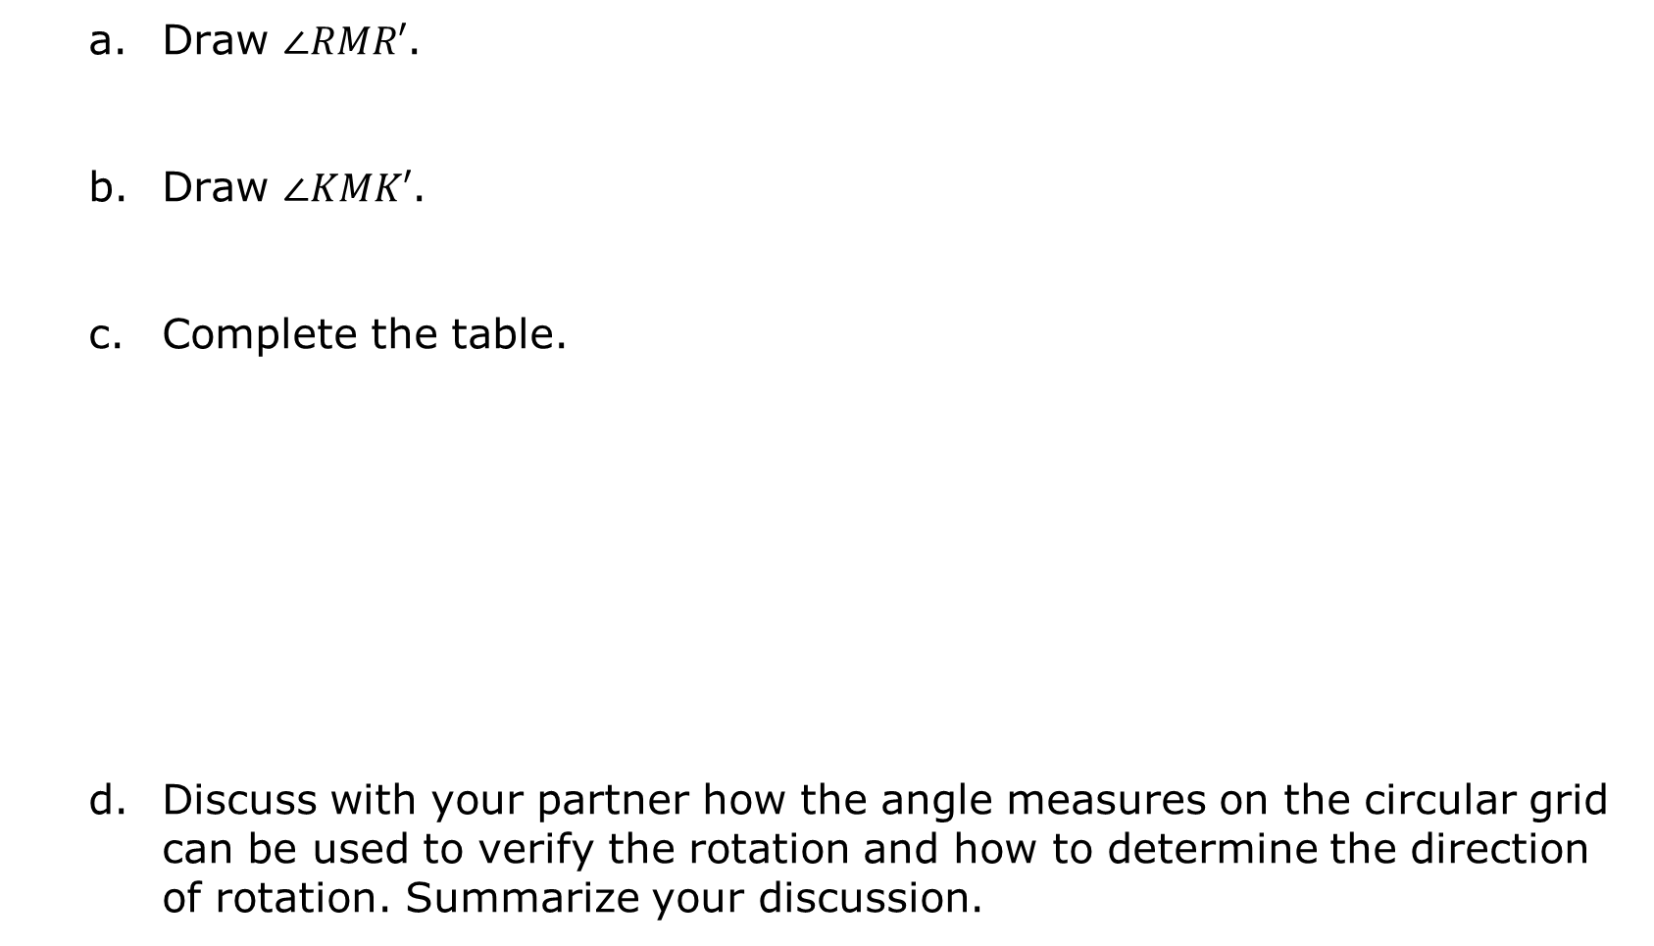
Draw $∠RMR′$.
Draw $∠KMK′$.
Complete the table.
Discuss with your partner how the angle measures on the circular grid can be used to verify the rotation and how to determine the direction of rotation. Summarize your discussion.
 | Measurement (degrees)
$$∠XMX′$$
$$∠RMR′$$
$$∠KMK′$$
volume 1, pg. 29

Slide 12

Identify the transformation of $∆RKX$. Describe the transformation using direction, degrees, or scale factor.
Discuss with your partner whether or not the transformation could be described as “a rotation of $270°$ clockwise centered at point $M$.” Explain why or why not.
Type of Transformation | Center, Line, or Movement | Description
Dilation Rotation Reflection Translation | Center of dilation is _____. Center of rotation is _____. Line of reflection is ______. Down Left Right Up
volume 1, pg. 30

Slide 13
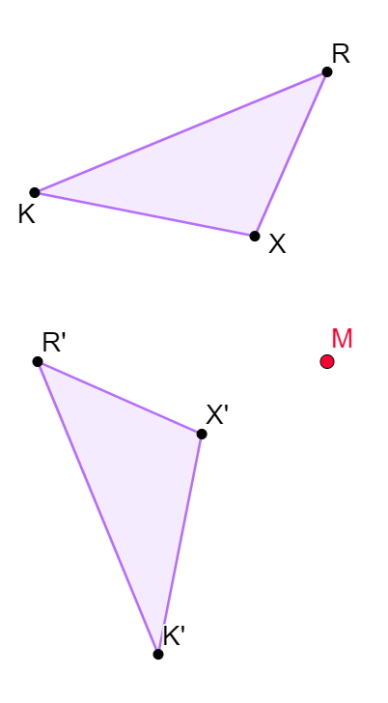
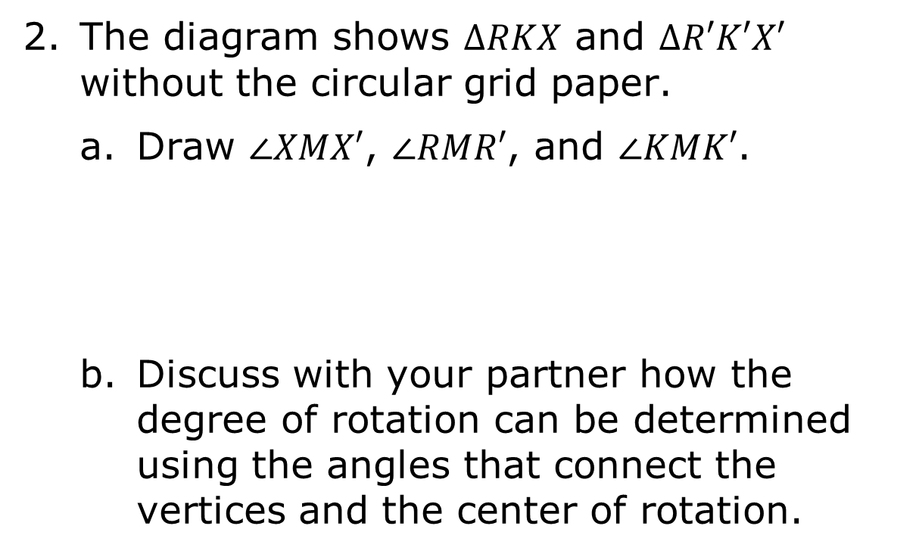
The diagram shows $∆RKX$ and $∆R′K′X′$ without the circular grid paper.
Draw $∠XMX′$, $∠RMR′$, and $∠KMK′$.
Discuss with your partner how the degree of rotation can be determined using the angles that connect the vertices and the center of rotation.
volume 1, pg. 30

Slide 14
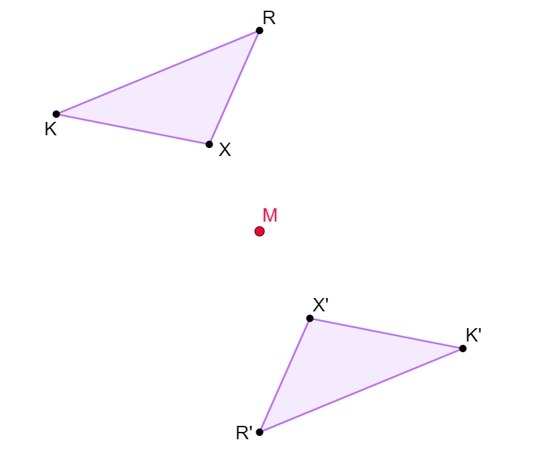
The diagram shows $∆RKX$ and $∆R′K′X′$ using a different transformation.
volume 1, pg. 31

Slide 15
Identify the transformation of $∆RKX$. Describe the transformation using direction, degrees, or scale factor.
Type of Transformation | Center, Line, or Movement | Description
Dilation Rotation Reflection Translation | Center of dilation is _____. Center of rotation is _____. Line of reflection is ______. Down Left Right Up
volume 1, pg. 31

Slide 16
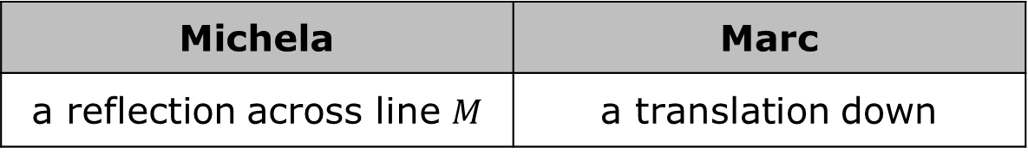
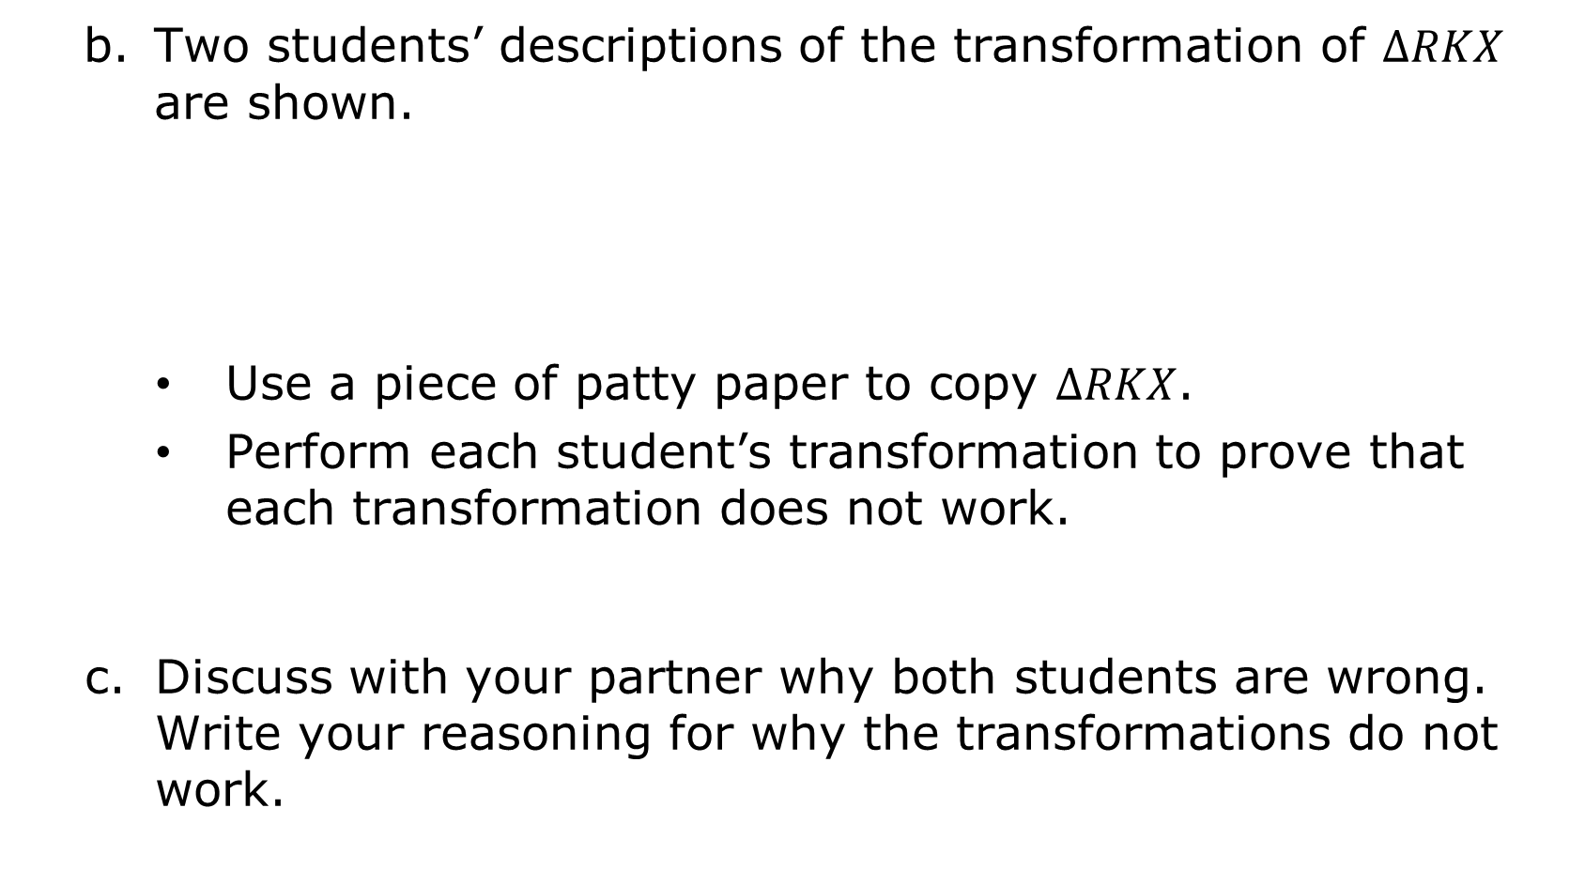
Two students’ descriptions of the transformation of $∆RKX$ are shown.
Use a piece of patty paper to copy $∆RKX$.
Perform each student’s transformation to prove that each transformation does not work.
Discuss with your partner why both students are wrong. Write your reasoning for why the transformations do not work.
Michela | Marc
a reflection across line $M$ | a translation down
volume 1, pg. 31

Slide 17
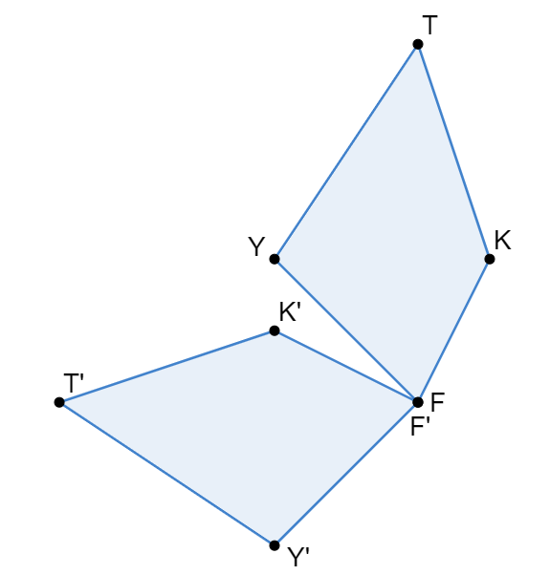
The diagram shows $TKFY$ and $T′K′F′Y′$.
volume 1, pg. 32

Slide 18
Identify the transformation of $TKFY$. Describe the transformation using direction, degrees, or scale factor.
Type of Transformation | Center, Line, or Movement | Description
Dilation Rotation Reflection Translation | Center of dilation is _____. Center of rotation is _____. Line of reflection is ______. Down Left Right Up
volume 1, pg. 32

Slide 19

Guided Practice
volume 1, pg. 32

Slide 20

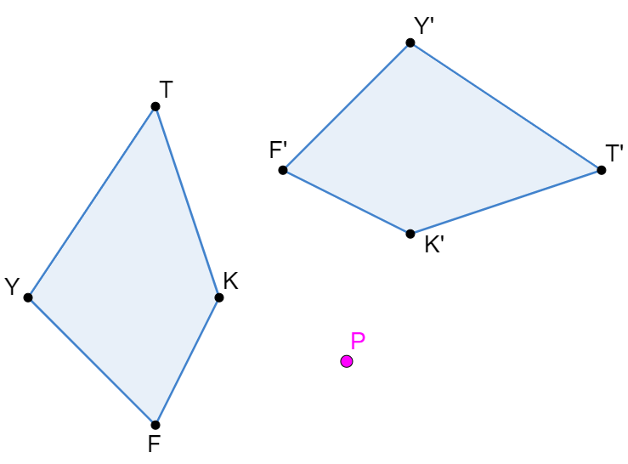
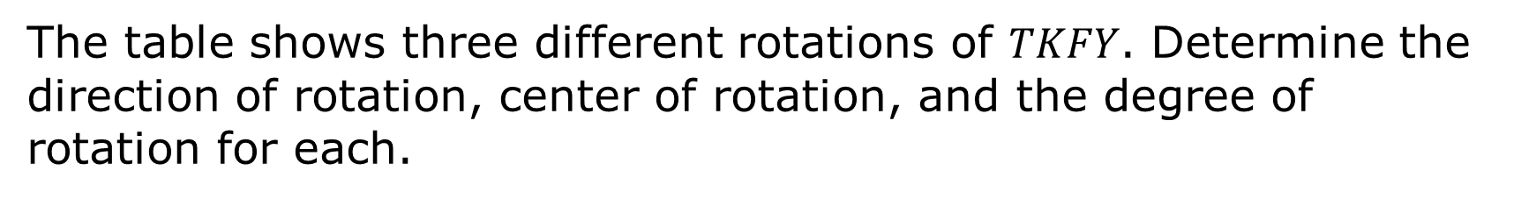
1.5.3 Guided Practice: Rotations
The table shows three different rotations of $TKFY$. Determine the direction of rotation, center of rotation, and the degree of rotation for each.
Transformation | Direction, Center, and Degree
 | Direction of rotation is ________. Center of rotation is ________. Degree of rotation is ________.
volume 1, pg. 32

Slide 21
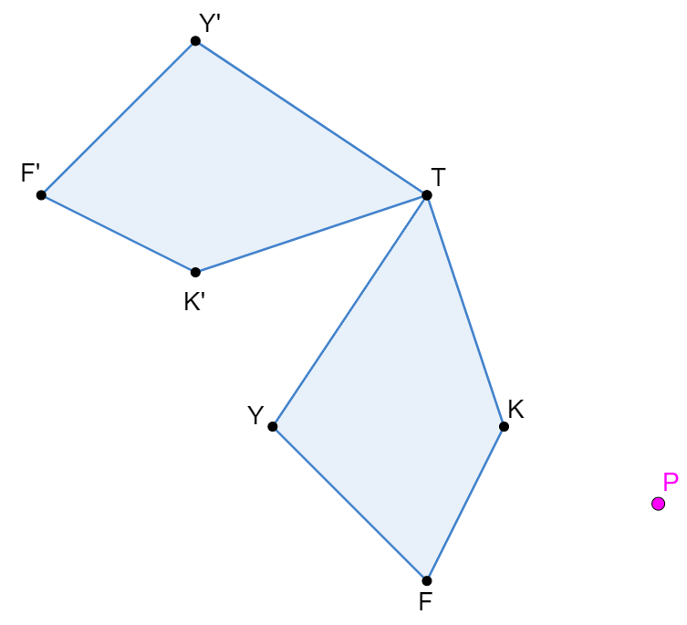
Transformation | Direction, Center, and Degree
 | Direction of rotation is ________. Center of rotation is ________. Degree of rotation is ________.
volume 1, pg. 32

Slide 22
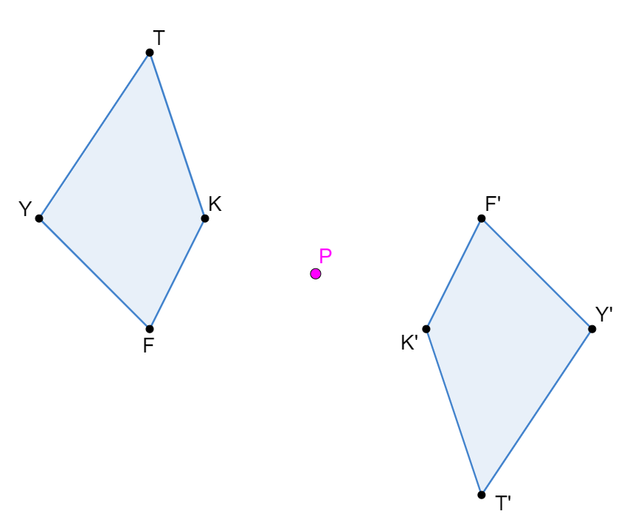
Transformation | Direction, Center, and Degree
 | Direction of rotation is ________. Center of rotation is ________. Degree of rotation is ________.
volume 1, pg. 33

Slide 23

Wrap-Up
volume 1, pg. 33

Slide 24
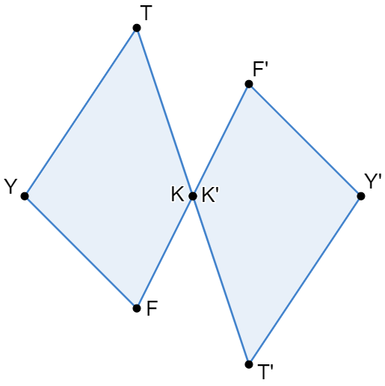
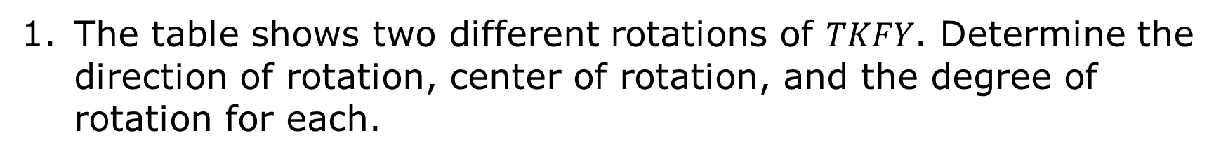
1.5.4 Wrap-Up: Ticket Out the Door
The table shows two different rotations of $TKFY$. Determine the direction of rotation, center of rotation, and the degree of rotation for each.
Transformation | Direction, Center, and Degree
 | Direction of rotation is ________. Center of rotation is ________. Degree of rotation is ________.
volume 1, pg. 33

Slide 25
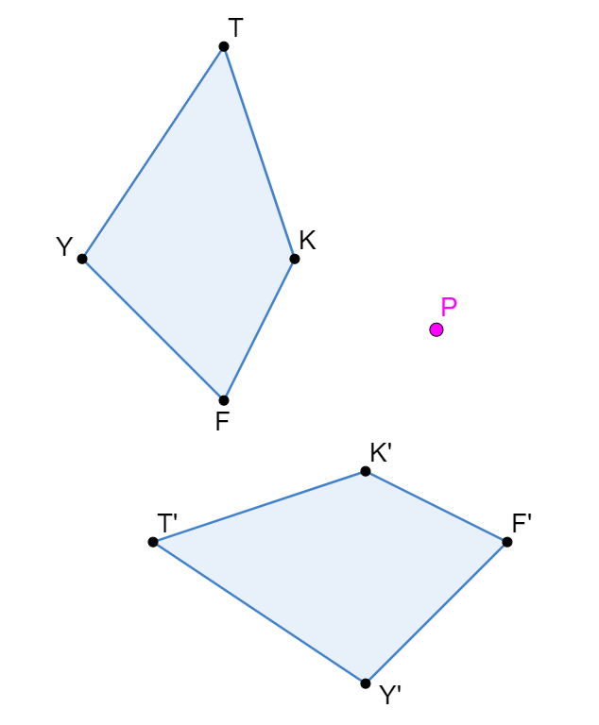
Transformation | Direction, Center, and Degree
 | Direction of rotation is ________. Center of rotation is ________. Degree of rotation is ________.
volume 1, pg. 33

